Slide 1

Worknet Dupage One Stop Operator October 2025 Report to LWIB August & September Activity

Slide 2

AGENDA
Review
By the numbers August & September 2025
Keeping an eye out for trends
Thank you

Slide 3

Western DuPage Chamber of Commerce One Stop Operator At the last Workforce Innovation Board meeting in August, we discussed the Partner activities being reported and what steps we might take to create additional efficiencies. Email responses from Partners was seen as a cumbersome task with the potential to create confusion for applicants. Automating these responses and combining multiple agencies into a single response when appropriate, could result in clearer communication and reduce staff time on the repetitive task. At the Partner meeting in September, we requested that copies of all templated responses be forwarded to the OSO. Annie Davis, Senior Network Analyst also met with the OSO to talk about strategy and system capability. An invitation to schedule a meeting with Craig Meyer, Larry Blackburn and the OSO has been sent and we hope to meet in the coming weeks to evaluate the tech solutions and scope of the project. Okay, let’s get to work!

Slide 4

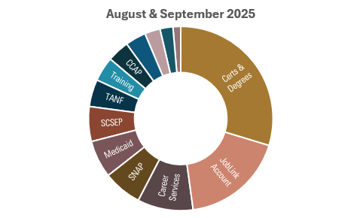
Applications
workNet DuPage
(DuPage County)
staff received:
Aug. & Sept Comb.
Long Term Aps = 457
Short Term Aps = 46
 | COD |  |  |  | IDES |  | DHS |  |  |  | CAPs | workNet DuPage
REFERRAL TOTALS BY MONTH | ELA | GED | Certs & Degrees | DRS | JobLink Account | Veterans Services | CCAP | Medicaid | SNAP | TANF | SCSEP | Career Services | Training | MONTH TOTAL
Aug. 2025 | 10 | 12 | 131 | 16 | 80 | 6 | 17 | 29 | 30 | 21 | 27 | 43 | 19 | 441
Sept. 2025 | 3 | 10 | 100 | 21 | 73 | 5 | 16 | 30 | 27 | 17 | 16 | 44 | 25 | 387

Slide 5

Outcome / activity
 |  | COD |  |  |  | IDES |  |  | CAPs
 | OUTCOMES BY MONTH | ELA | GED | Certs & Degrees | DRS | JobLink Account | Veterans Services | DHS | SCSEP | workNet DuPage
Aug. 2025 | Attempting to Contact | 0 |  | 0 | 2 | 0 | 1 | 22 | 7 | 0
 | Informational Email Sent | 16 |  | 89 | 0 | 83 | 0 | 0 | 3 | 46
 | Phone Conversation | 0 |  | 23 | 12 | 0 | 5 | 40 | 14 | 0
 | Email Conversation | 3 |  | 5 | 0 | 0 | 0 | 0 | 4 | 0
 | In-person Conversation | 0 |  | 16 | 0 | 0 | 0 | 0 | 0 | 0
Sept 2025 | Attempting to Contact | 0 |  | 0 | 0 | 1 | 1 | 14 | 6 | 0
 | Informational Email Sent | 12 |  | 57 | 0 | 69 | 0 | 0 | 1 | 45
 | Phone Conversation | 0 |  | 23 | 15 | 0 | 4 | 28 | 11 | 0
 | Email Conversation | 0 |  | 3 | 0 | 0 | 0 | 0 | 0 | 0
 | In-person Conversation | 0 |  | 12 | 0 | 0 | 0 | 0 | 0 | 0

Slide 6
Outcome Totals 2025 Q1
 |  | COD |  |  |  | IDES |  |  | CAPs
 | OUTCOME TOTALS | ELA | GED | Certs & Degrees | DRS | JobLink Account | Veterans Services | DHS | SCSEP | workNet DuPage
PY25 | Attempting to Contact | 0 |  | 0 | 5 | 1 | 4 | 64 | 35 | 0
 | Informational Email Sent | 37 |  | 241 | 0 | 235 | 0 | 0 | 4 | 117
 | Phone Conversation | 0 |  | 79 | 42 | 1 | 12 | 99 | 41 | 0
 | Email Conversation | 6 |  | 14 | 1 | 0 | 0 | 0 | 4 | 0
 | In-person Conversation | 0 |  | 34 | 0 | 0 | 0 | 0 | 0 | 0

Slide 7

To keep an eye on
While the numbers are too small to identify a trend,
They are worth keeping an eye on.
English language applicants generally number just below GED applicants except in September with only 3 v/s 10.
In PY2024 ELA 95 / GED 112
This represents a decline from near 85% to 30%

Slide 8

THANK YOU
David J Sabathne
630-231-3003
dave@westerndupagechamber.com
oso@worknetdupage.org

